Slide 1
Lesson 1 - GitHub + IntelliJ IDEA

Slide 2



Software to Download and Install
Git
https://git-scm.com/downloads
JDK 17
https://www.oracle.com/java/technologies/downloads
IntelliJ IDEA Community Edition
https://www.jetbrains.com/idea/download

Slide 3
Register on GitHub.com
Go to https://github.com
Register using your Full Name (ex. Yaroslav Brahinets)
Go to https://github.com/settings/profile
Upload your photo (same as for slack) as avatar

Slide 4
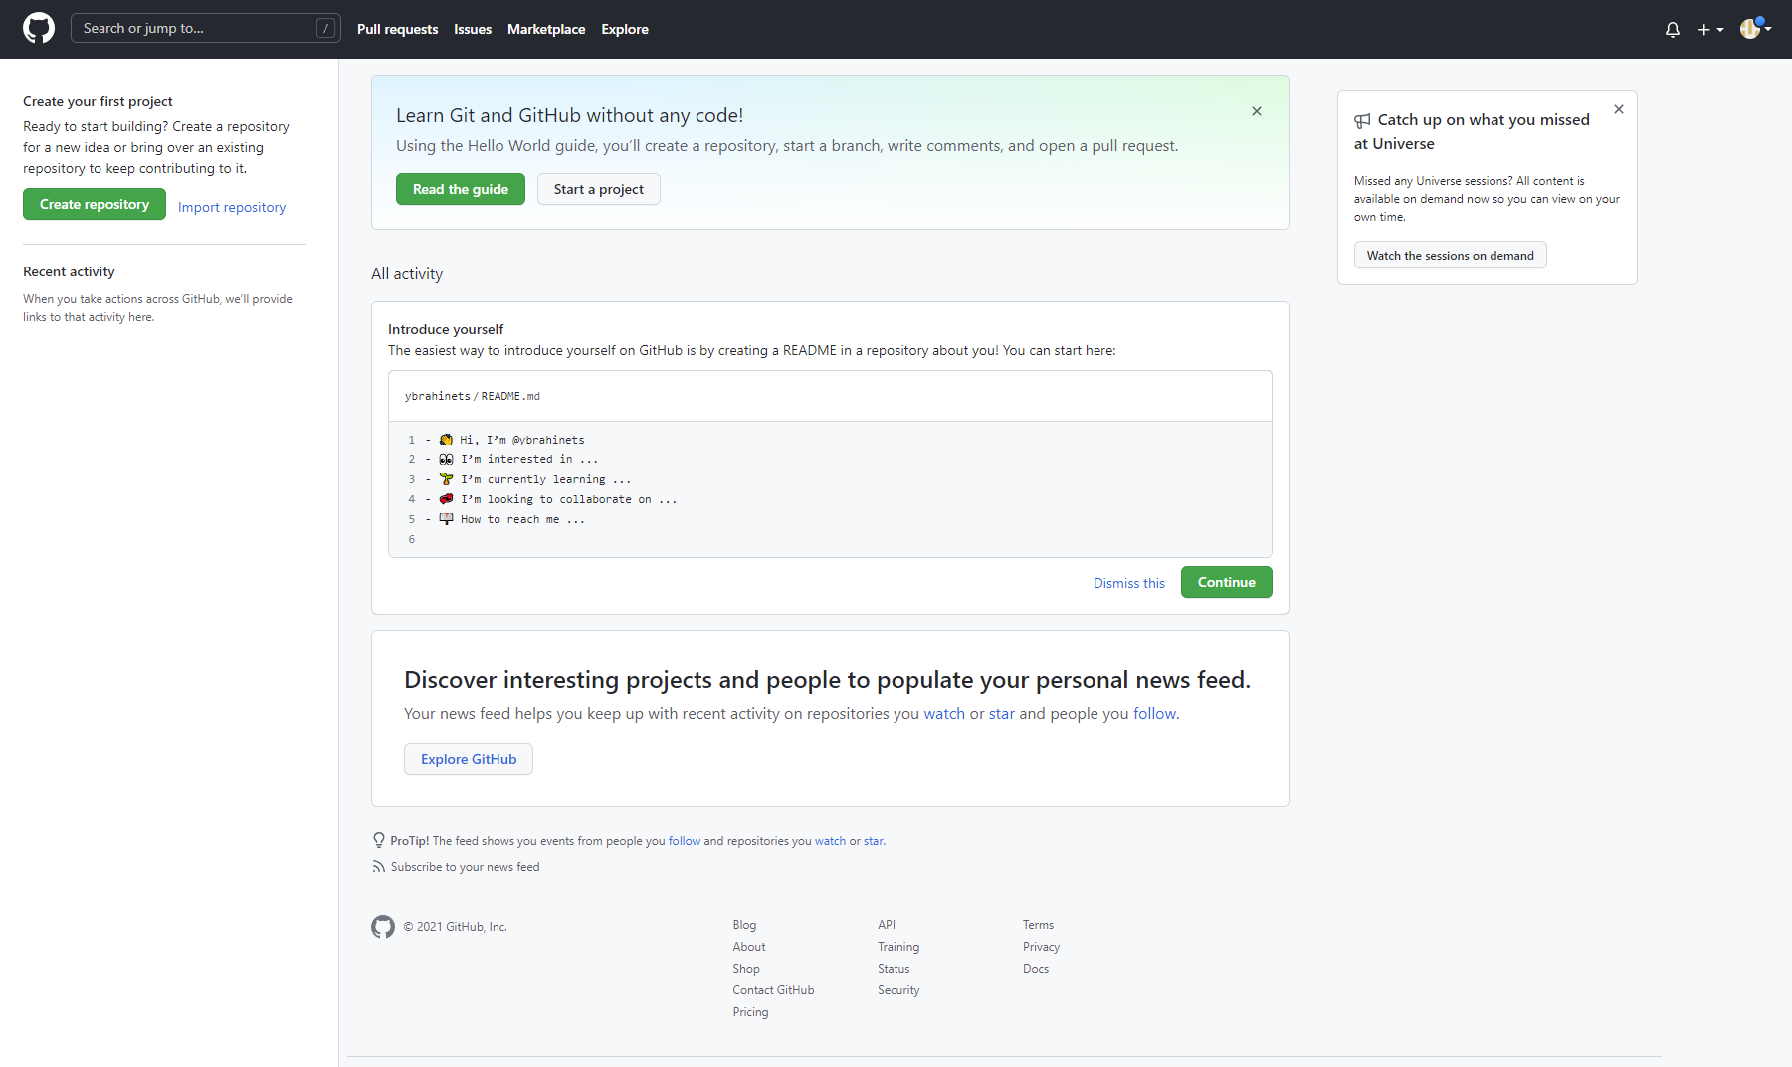
Register on GitHub.com

Slide 5
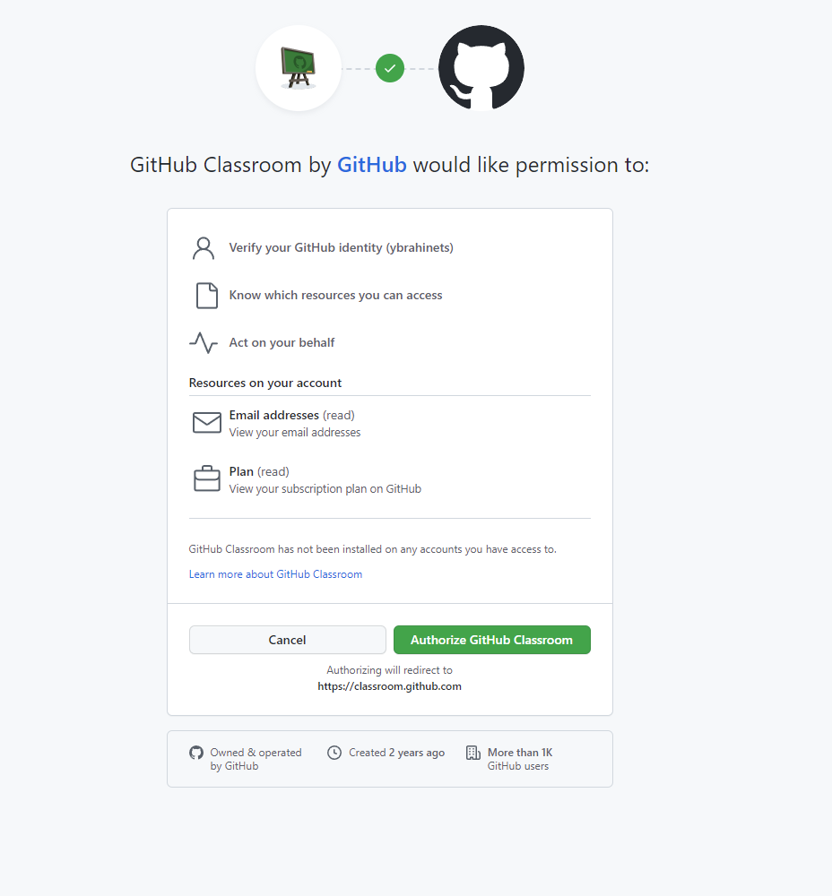
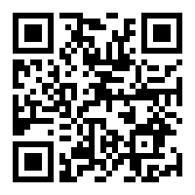
Join the classroom
Join the Classroom via link or QR

Slide 6
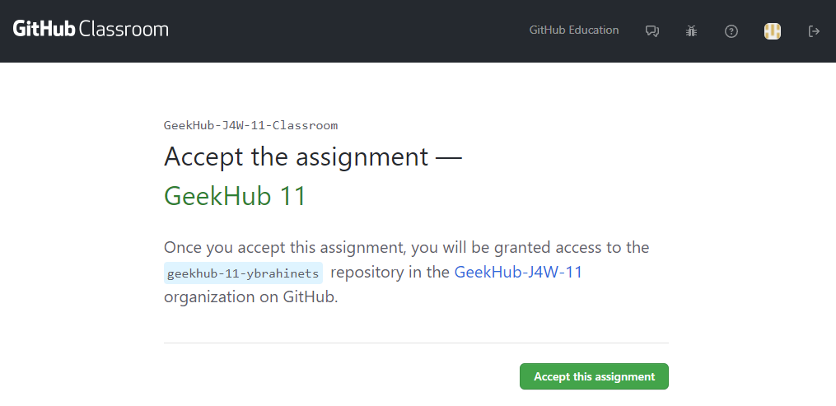
Complete GeekHub 11 Classroom setup

Slide 7
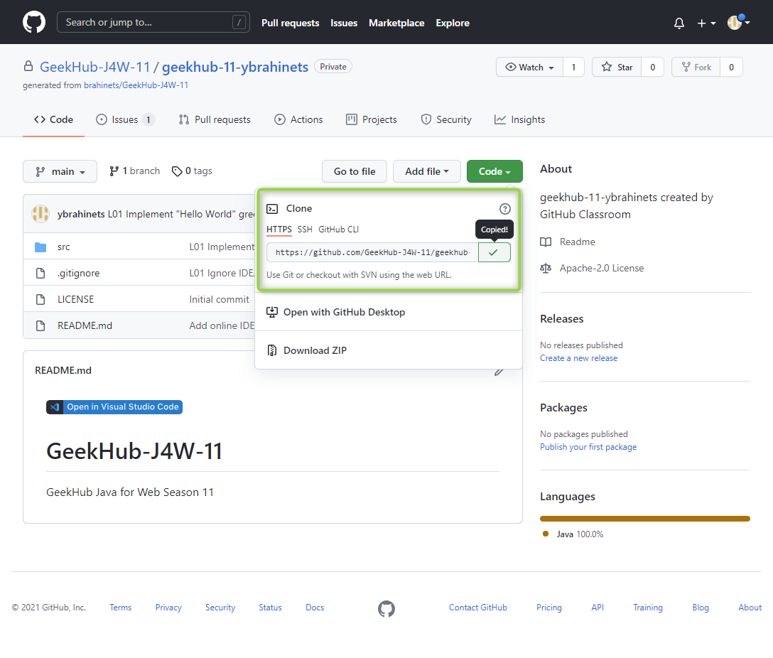
Import project into IDEA
Click “Project” -> “Details” in sidebar menu
Choose HTTPS type of link
Copy link to your repository

Slide 8
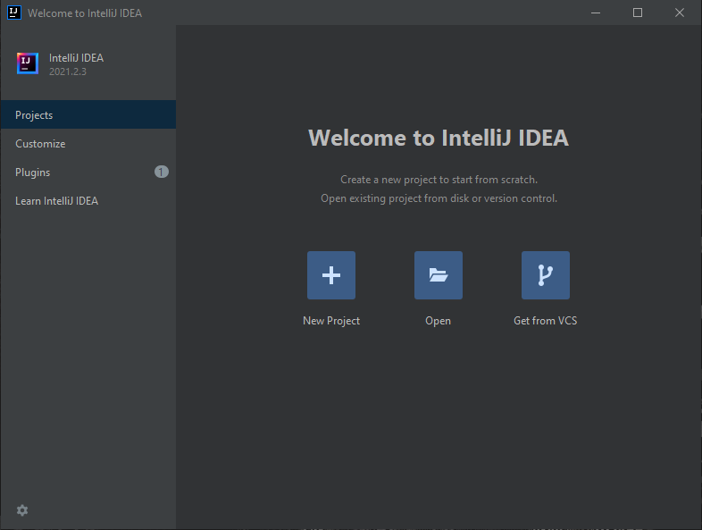
Import project into IDEA
Open IntelliJ IDEA
Choose “Get from VCS”
Choose “Git”

Slide 9
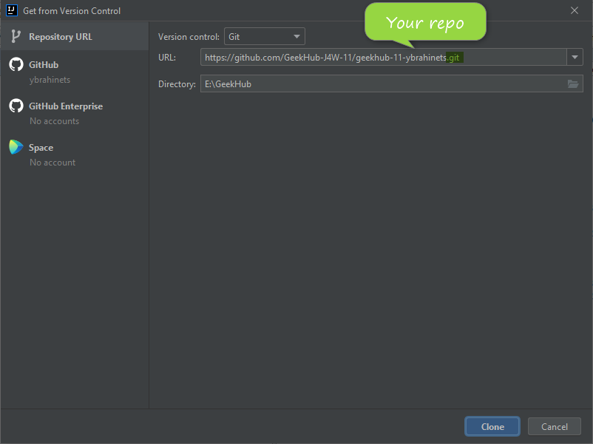
Import project into IDEA
Paste copied link of repository into just opened window
Click “Clone”

Slide 10
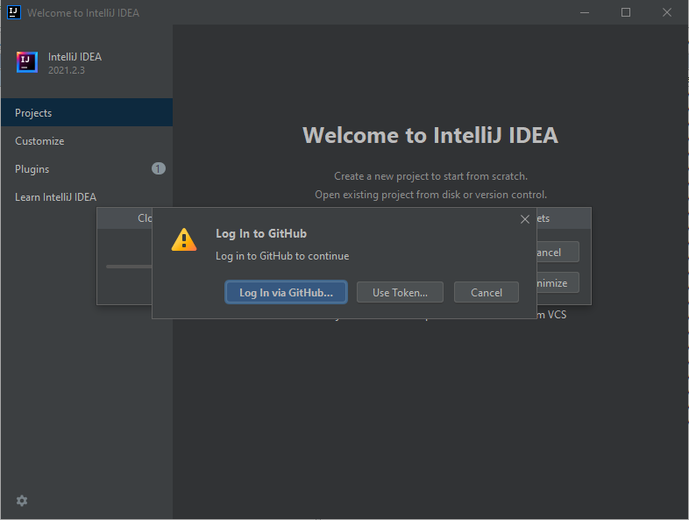
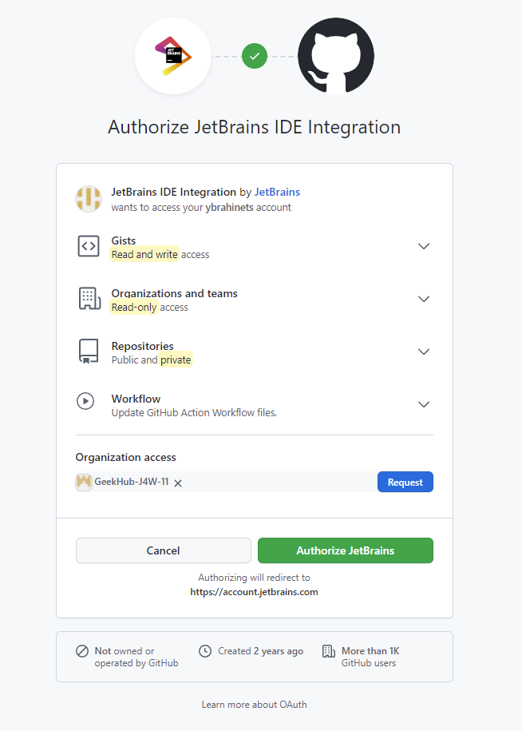
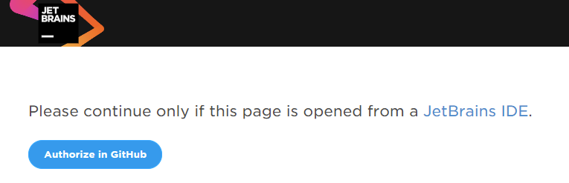
Import project into IDEA
Input your login and password (or token) for GitHub.com if required

Slide 11
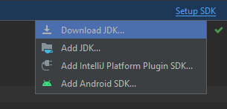
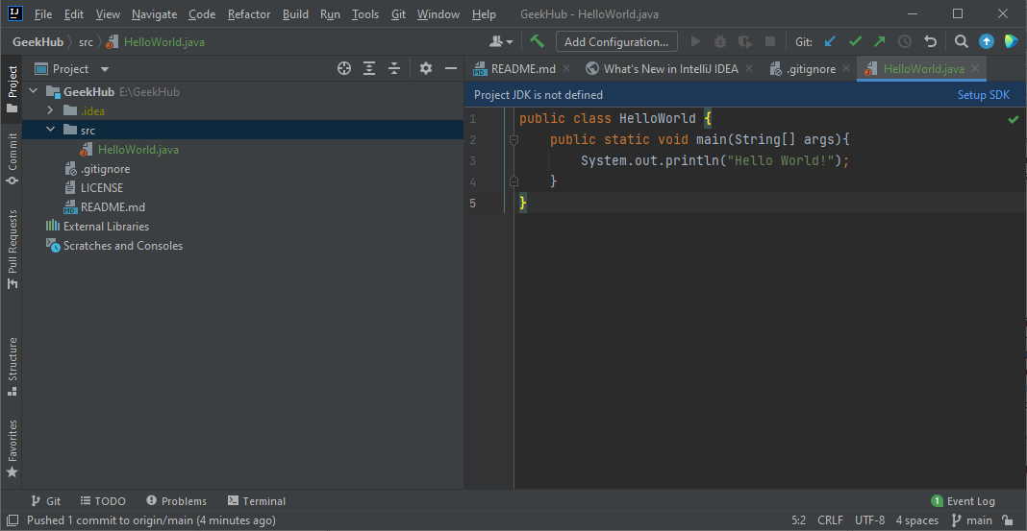
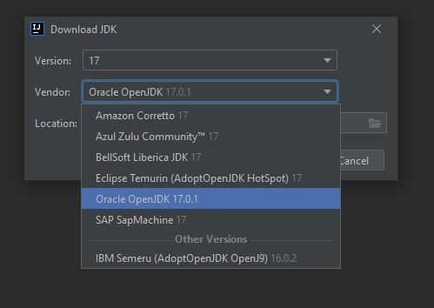

Setup JDK via IDEA Assistant

Slide 12
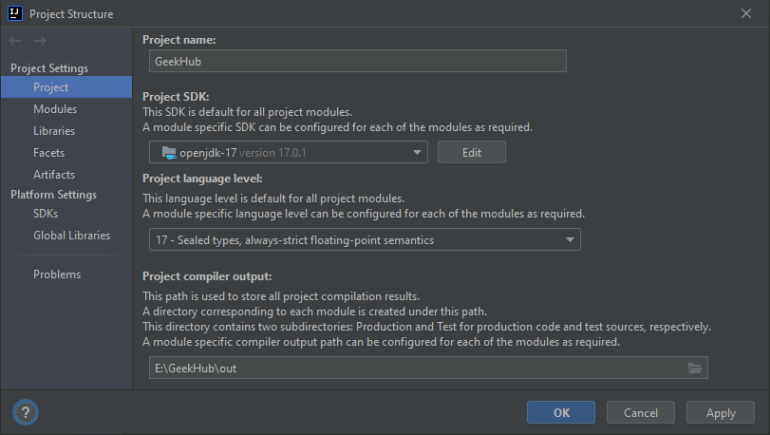
Setup Project SDK
Install Java.
Open project in IDEA
Choose “Project” tab
Add new JDK for IDEA by clicking “Edit” button, if required
Choose JDK 17 for your project
Choose “Project language level”: 17 – Sealed types…
Click “OK”

Slide 13
IDE Plugins

Slide 14
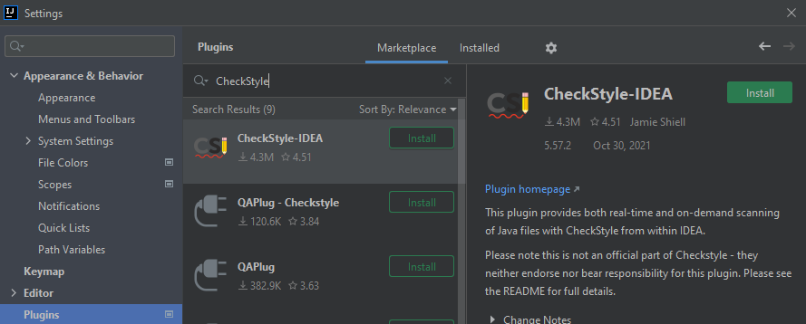
Setup CheckStyle Plugin for IDEA
How to install plugin in Intellij IDEA read here
Install required CheckStyle plugin

Slide 15
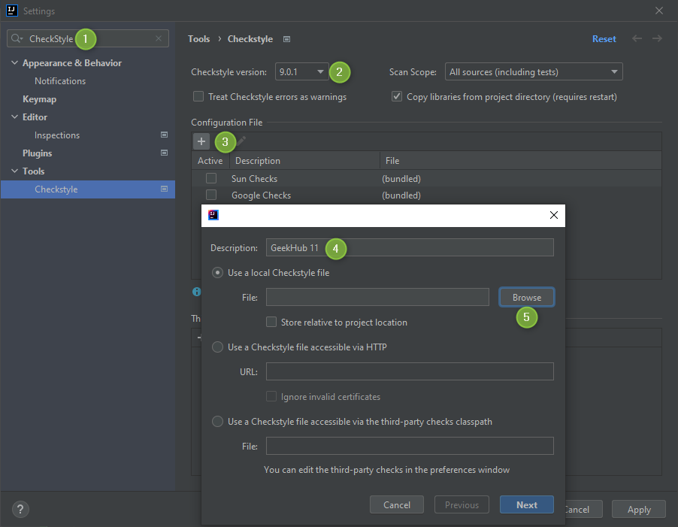
Setup CheckStyle Plugin for IDEA
Go to IDEA Preferences (Ctrl + Alt + S)
Find CheckStyle settings
Set CheckStyle version “9.0.1” (important)

Slide 16
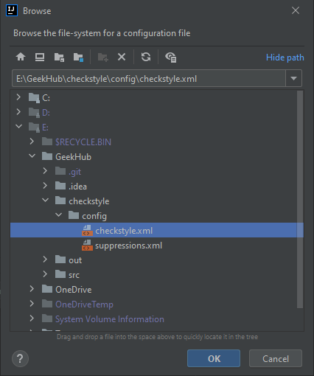
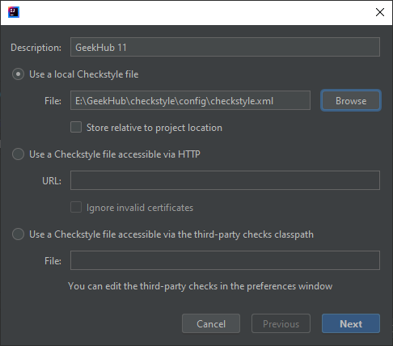
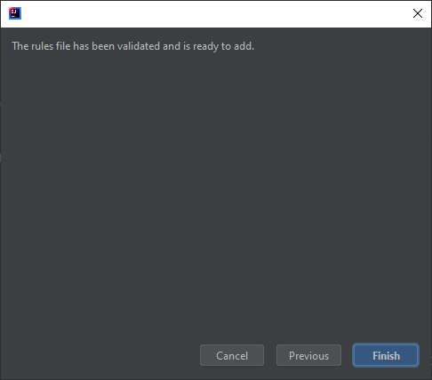
Setup CheckStyle Plugin for IDEA
Add custom checkstyle rules(/config/checkstyle/checkstyle.xml)

Slide 17
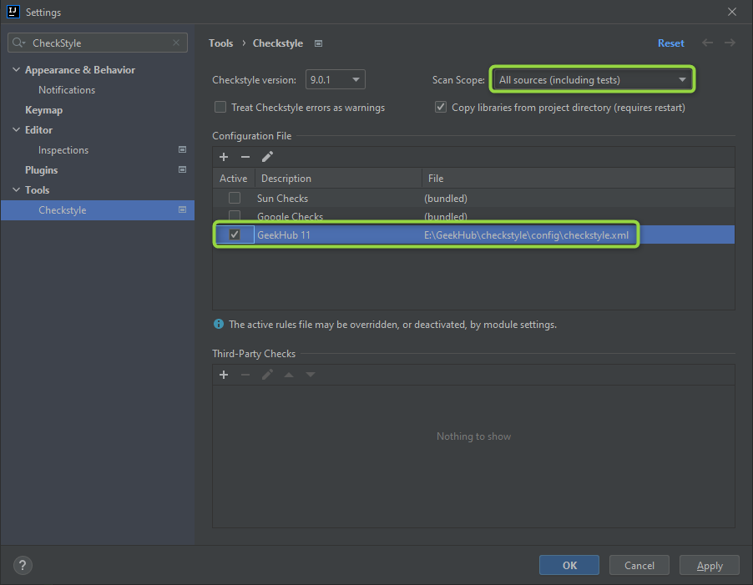
Setup CheckStyle Plugin for IDEA
Set a “GeekHub Checks” as a default for project

Slide 18


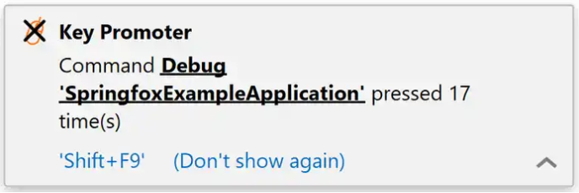
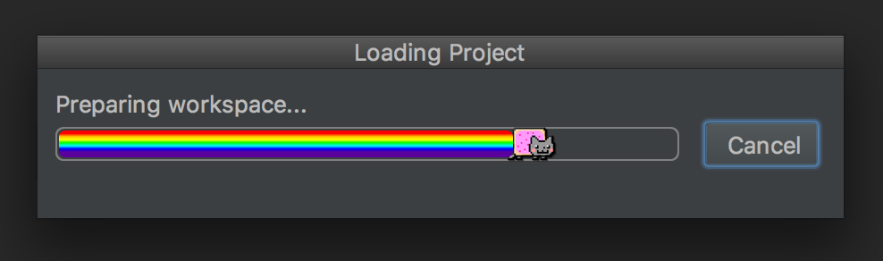
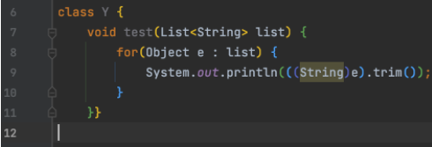
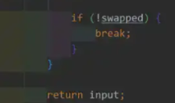
Faster and fun development
Key Promoter X and IDE Features Trainer
Rainbow brackets or Indent Rainbow
Sonarlint
Nyan Progress Bar

Slide 19
.gitignore and first commit

Slide 20
Create .gitignore file
Read info about .gitignore
Find .gitignore file in a root of project folder
Add missing lines:
.idea *.iml out/ build/ classes/ .gradle /libs/

Slide 21
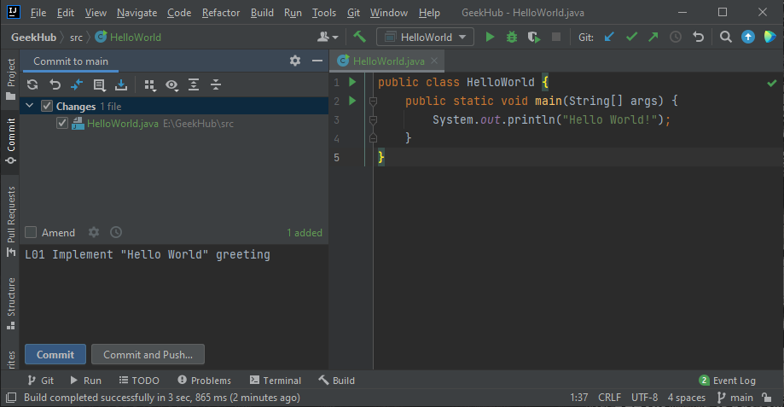
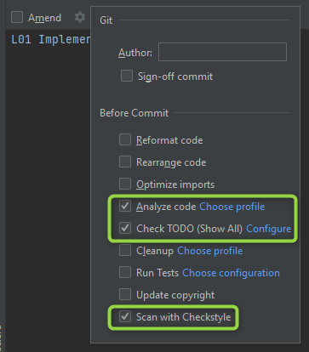
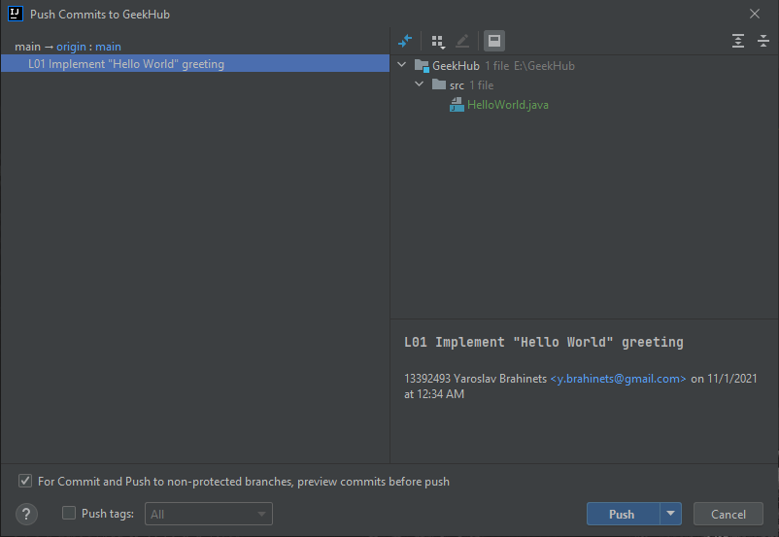
First Commit and Push to Git
You have made some changes, it’s time to commit and push
Press “Ctrl+K” to make commit
Choose files that should be committed
Type understandable and informative “L## Commit Message”
Check checkboxes: “Perform code analysis”, “Check TODO” and “Scan with CheckStyle”
Click “Commit”

Slide 22
GitHub issue

Slide 23
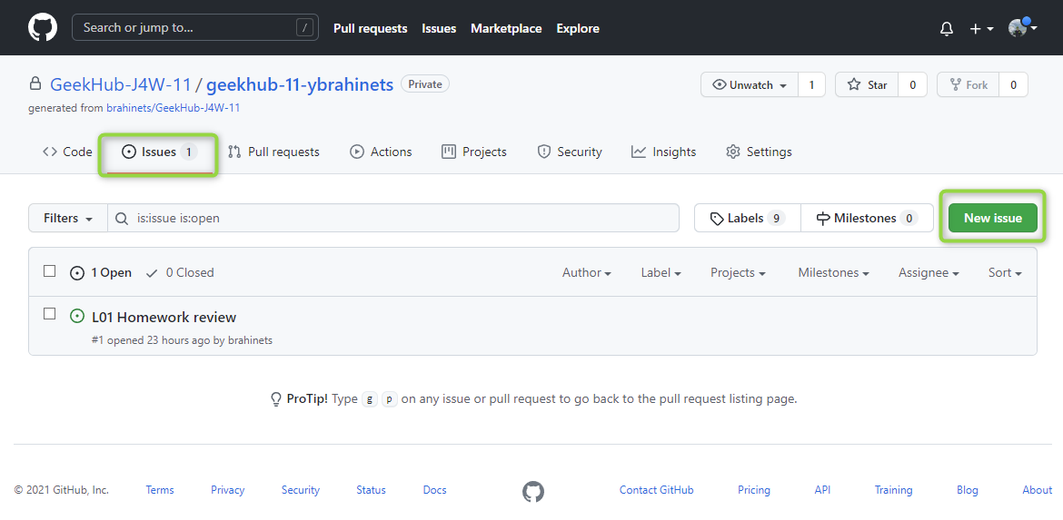
Create issue

Slide 24
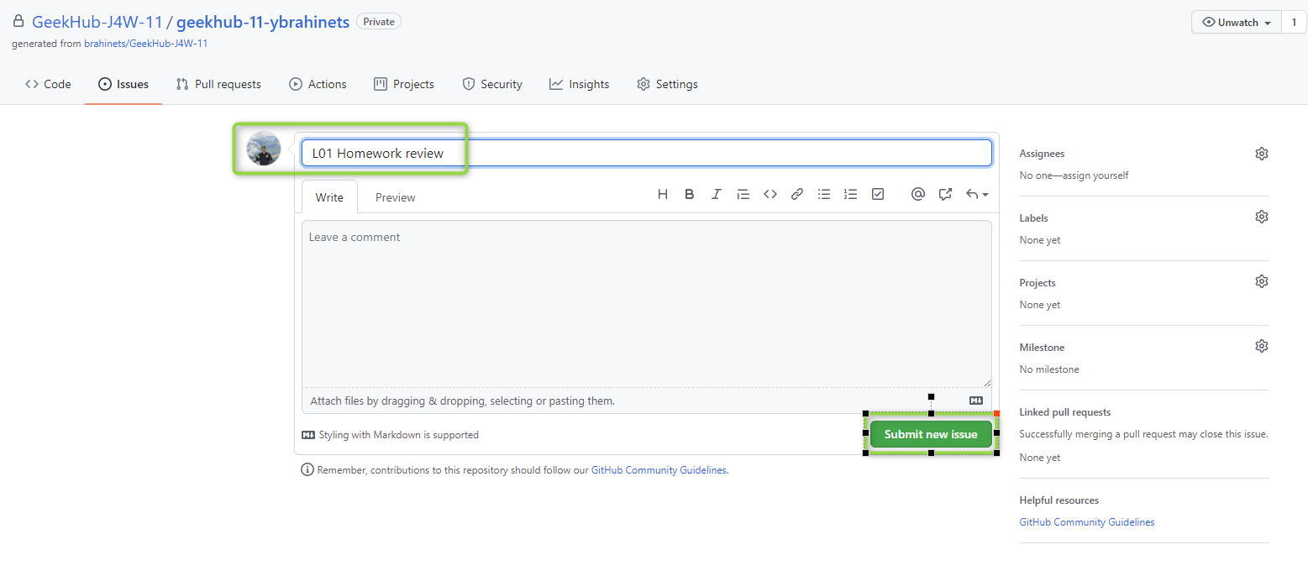
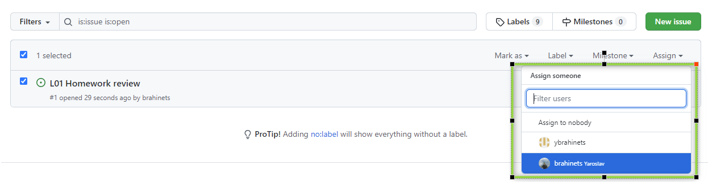
Create issue
Title: L## Homework Review
Assignee: Lector that was on lection

Slide 25
Literature
Gamified git tutorial from Stanford
https://git-scm.com/book/en/v2
https://try.github.io
https://gitlhub.com/help

